Slide 1

Java Design Patterns
09/10/2018

Slide 2
Design Patterns Introduction

Slide 3
What is a Design Pattern?
A (Problem, Solution) pair.
Solutions to general software development problems.
Best practices of experienced object-oriented software developers.
A technique to repeat designer success.
Notes:
Each pattern describes a problem which occurs over and over again in our environment, and then describes the core of the solution to that problem, in such a way that you can use this solution a million times over, without ever doing it the same way twice.

Slide 4
Why we need design patterns ?
Architecture and Dependencies
Design pattern suggest specific implementation for the specific object oriented programming problem
Design pattern provides low level solution (implementation) to design better software applications.
Patterns explicitly capture expert knowledge and design tradeoffs, and make this expertise more widely available
Notes:
Rigidity - Rigidity is the tendency for software to be difficult to change, even in simple ways. Every change causes a cascade of subsequent changes in dependent modules.
Fragility - Fragility is the tendency of the software to break in many places every time it is changed. Often the breakage occurs in areas that have no conceptual relationship with the area that was changed.
Immobility - Immobility is the inability to reuse software from other projects or from parts of the same project.
Viscosity - viscosity of the design, and viscosity of the environment

Slide 5
Caution
Design patterns should be used in moderation
This is a hammer
-Not all problems are nails

Slide 6
Design Patterns Categories
Creational Patterns | Structural Patterns | Behavioral Patterns
Prototype | Decorator | Observer
Singleton | Adapter | Template Method
Factory | Flyweight | Visitor
Builder | Proxy | Chain of Responsibility
 | Façade | State
 |  | Strategy
 |  | Iterator
 |  | Command
 |  | Memento
 |  | Mediator

Slide 7
Prototype
A fully initialized instance to be copied or cloned
Definition
Prototype allows us to hide the complexity of making new instances from the client. The concept is to copy an existing object rather than creating a new instance from scratch. The existing object acts as a prototype and contains the state of the object. The newly copied object may change same properties only if required. This approach saves costly resources and time, especially when the object creation is a heavy process.
Problem & Context
When clients need to create a set of objects that are cost prohibitive and alike or differ only in terms of their state, create one object upfront and designate it as a prototype object or simply make a copy of the prototype object
Implementation
Provide a way for clients to create a copy of the prototype object. By default, all Java objects inherit the built in clone() method that creates a clone of the original object
Notes:
Frequency of use: medium low (2 of 5)
Sample Application:
New Color objects are created by copying pre-existing, user-defined Colors of the same type.
Every new Supervisor type account is given exactly the same set of permissions as the prototypical Supervisor UserAccount object. Consider a new user account group to represent marketing coordinators, with additional permission to access the color printer.

Slide 8
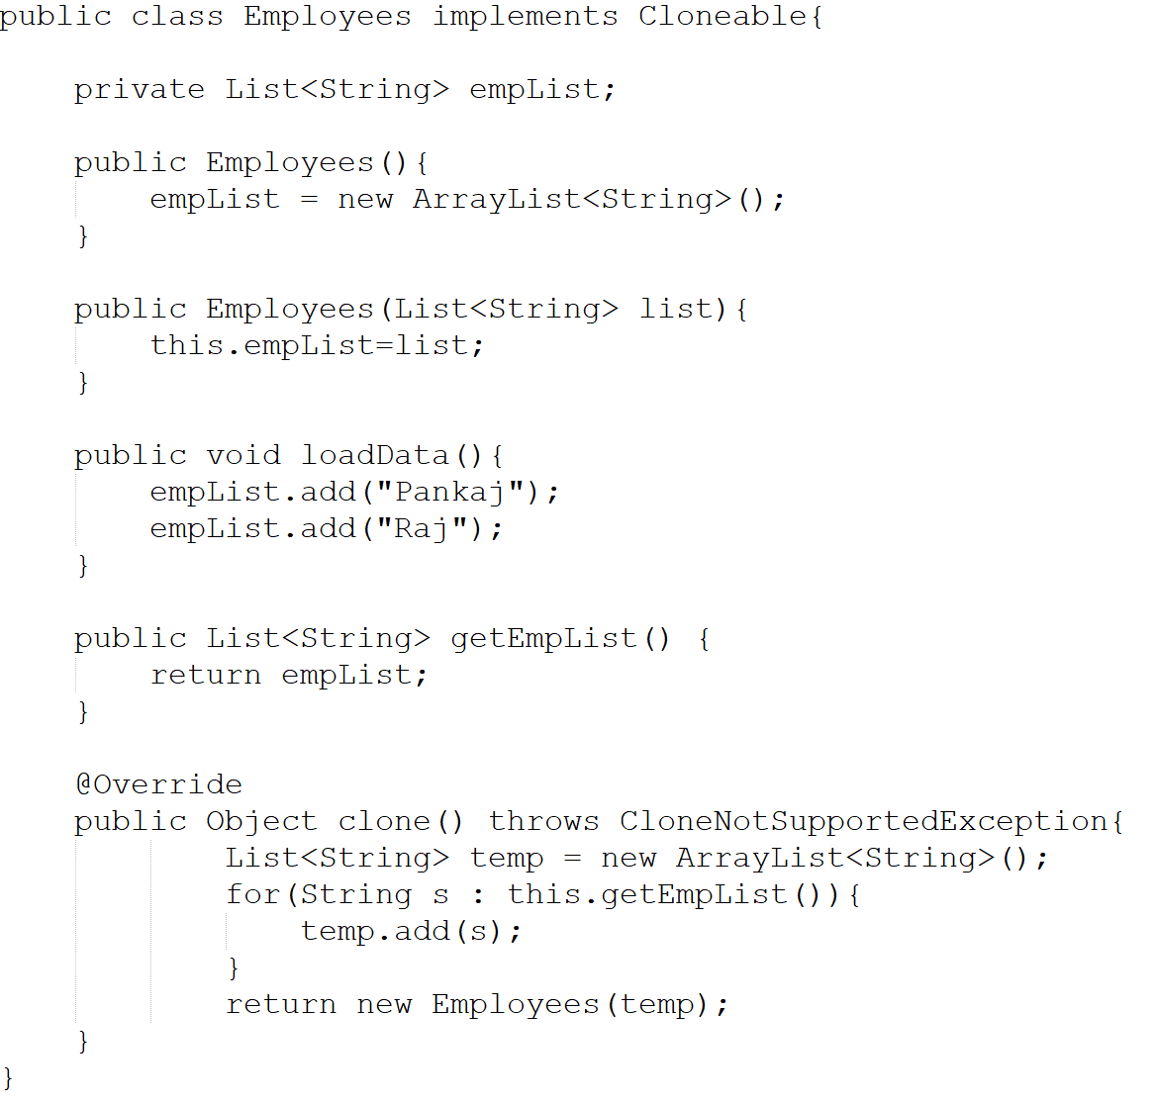
Example

Slide 9
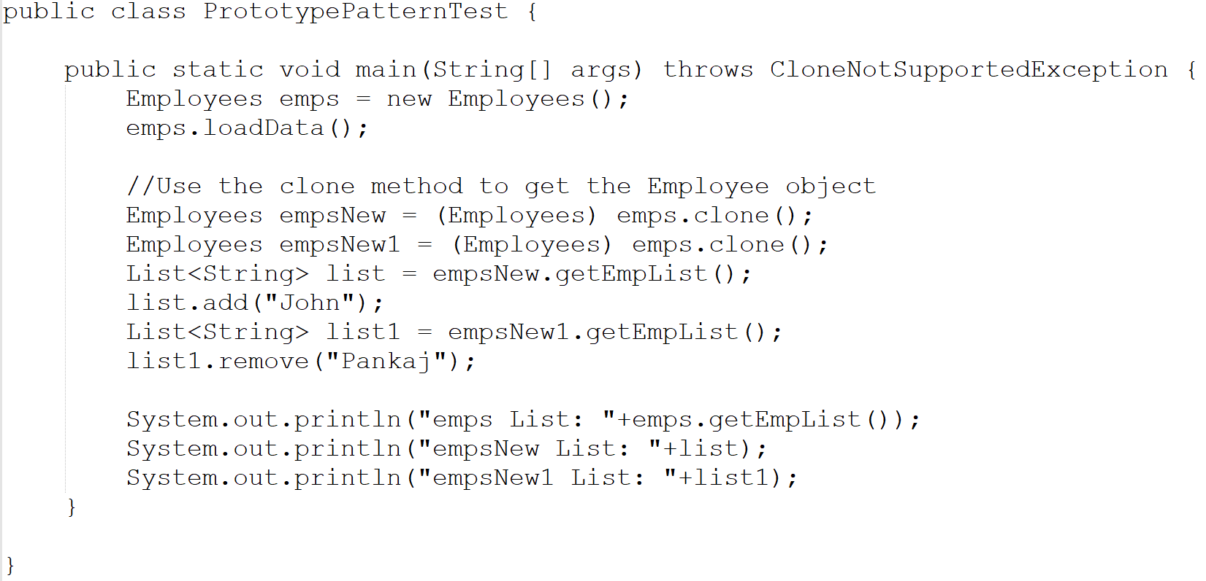
Example

Slide 10
Singleton
One instance of a class or one value accessible globally in an application.
Definition
Defines an Instance operation that lets clients access its unique instance and responsible for creating and maintaining its own unique instance.
Problem & Context
If an object needs to know the selection criteria to instantiate an appropriate class, this results in a high degree of coupling. Whenever the selection criteria change, every object that uses the class must be changed correspondingly
Implementation
Create a class with a method that creates a new instance of the object if one does not exist. If one does exist, it returns a reference to the object that already exists. To make sure that the object cannot be instantiated any other way, the constructor is made either private or protected
Notes:
Frequency of use: High (5 of 5)
Sample Application:
Consider a LoadBalancing object. Only a single instance (the singleton) of the class can be created because servers may dynamically come on- or off-line and every request must go through the one object that has knowledge about the state of the (web) farm.
A single database connection object in an application

Slide 11
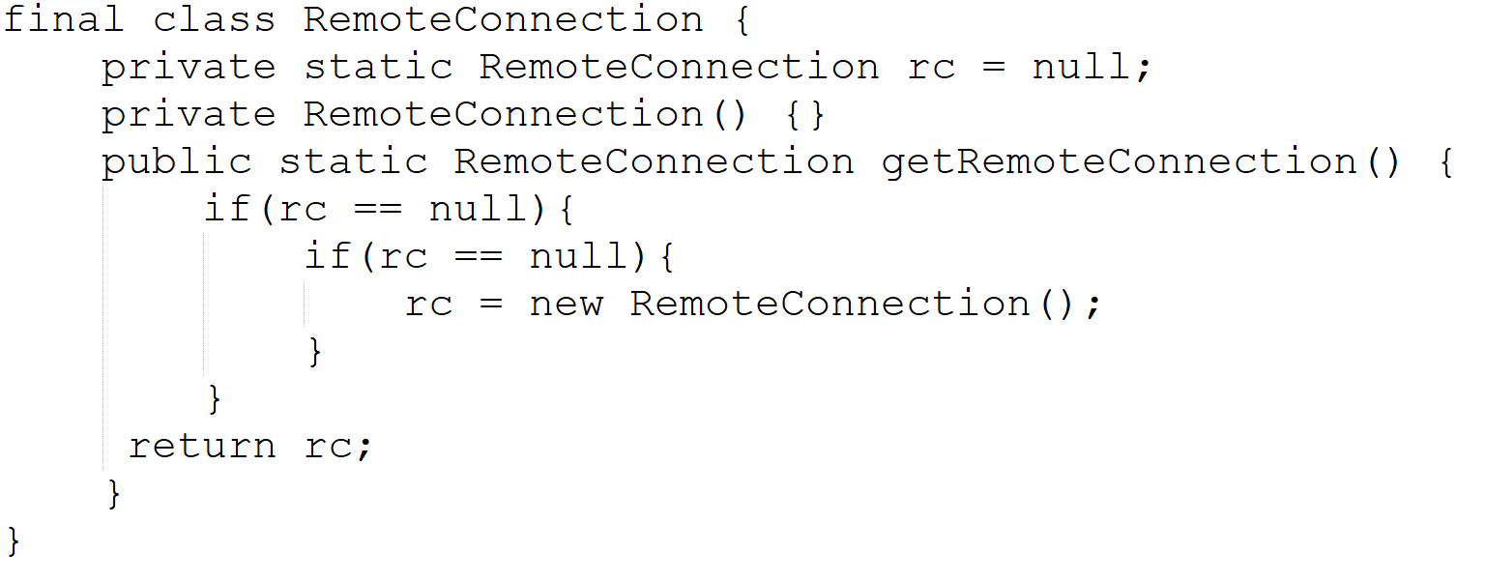
Example

Slide 12
Factory
Responsibility of object instantiation.
Definition
Defines an interface for creating an object, but let subclasses decide which class to instantiate. Factory Method lets a class defer instantiation to subclasses
Problem & Context
If an object needs to know the selection criteria to instantiate an appropriate class, this results in a high degree of coupling. Whenever the selection criteria change, every object that uses the class must be changed correspondingly
Solution
Encapsulate the functionality required to select and instantiate the appropriate class. One way to do this is to create an abstract class or an interface that declares the factory method. Different subclasses can then implement the method in its entirety
Notes:
Frequency of use: Medium high (4 of 5)
Sample Application:
Creating different documents (e.g., Report, Resume, etc…) from a base Document class.

Slide 13
Builder
Separates the construction
Definition
Separates the construction of a complex object from its representation so that the same construction process can create different representations
Problem & Context
Object construction details are kept within the object as part of its constructor. This may not be effective when the object being created is complex and the object creation process produces different representations of the object. The object can become bulky (construction bloat) and less modular
Implementation
Move the construction logic out of the object class to separate classes referred to as builder classes. A dedicated object referred to as a Director, is responsible for invoking different builder methods required for the construction of the final object. Different client objects can make use of the Director object to create the required object
Notes:
Frequency of use: medium (3 of 5)
Sample Application:
1. Different vehicles are assembled in a step-by-step fashion. The Shop uses VehicleBuilders to construct a variety of Vehicles in a series of sequential steps.
2. A Web hosting company offers three different types of hosting packages — Basic, Premium and Premium Plus — on Windows & Unix platforms. Then, query the features of different types of hosting packages offered by the Web hosting company.

Slide 14
Decorator
Definition
Attaches additional responsibilities to an object dynamically. Decorators provide a flexible alternative to subclassing for extending functionality
Problem & Context
This pattern allows new/additional behavior to be added to an existing method of an object dynamically. Since classes cannot be created at runtime and it is typically not possible to predict what extensions will be needed at design time, a new class would have to be made for every possible combination. By contrast, decorators are objects, created at runtime, and can be combined on a per-use basis
Implementation
Pass the original object as a parameter to the constructor of the decorator, with the decorator implementing the new functionality. The interface of the original object needs to be maintained by the decorator
Notes:
Frequency of use: Medium high (4 of 5)
Sample application:
A File Reader utility class with a method to read lines from a file
The scrollbar in web browsers will display only if necessary and hides itself otherwise. The scrollbar is the decorator to the web page.

Slide 15
Adapter
Definition
It allows the interface of an existing class to be used as another interface. In summary, an adapter helps two incompatible interfaces to work together. To implement the Adapter Design Pattern in Java, we choose the following example
Problem & Context
Sometimes an existing class may provide the functionality required by a client, but its interface may not be what the client expects. In such cases, the existing interface needs to be converted into an interface that the client expects, preserving the reusability of the existing class
Implementation
Define a wrapper class around the object with the incompatible interface. The adapter provides the required interface expected by the client. The implementation of the adapter interface converts client requests into calls to the adaptee class interface
Notes:
The interface used here refers to the programming interface that a class exposes. The programming interface is its set of methods.
Frequency of use: Medium high (4 of 5)
Sample Application
The use of a legacy chemical databank where Chemical compound objects access the databank through an Adapter interface.
Validate a given customer address using a larger customer data management application. The existing address validator is for the US but consider using it for residents of Canada.

Slide 16
Flyweight
Definition
Uses sharing to support large numbers of fine-grained objects efficiently
Problem & Context
This pattern suggests separating all the intrinsic common data into a separate object referred to as a Flyweight object. The group of objects being created can share the Flyweight object as it represents their intrinsic state. This eliminates the need for storing the same invariant, intrinsic information in every object; instead it is stored only once in the form of a single Flyweight object
Implementation
Design flyweight as a singleton with a private constructor. The client creates an object with the exclusive extrinsic data or sends the extrinsic data as part of a method call to the Flyweight object. This results in the creation of few objects with no duplication
Notes:
Frequency of use: Medium low (2 of 5)
Sample application:
The characters stored in a word processor represent objects that have font face, font size, and other formatting data. Each of the character objects would contain a reference to a separate formatting object which contains the required properties.
An online job site that receives data files from different employers with current openings in their organizations. Many of the data are the same for all jobs for a given employer.

Slide 17
Proxy
Definition
Provides a surrogate or placeholder for another object to control access to it
Problem & Context
A client object can directly access a service provider object but sometimes a client object may not have access to a target object by normal means. The reasons could be: location, state of existence, and special behavior of target object. Instead of having client objects to deal with the special requirements for accessing the target object, the Proxy pattern suggests using a separate object referred to as a proxy to provide a means for different client objects to access the target object in a normal, straightforward manner
Implementation
A proxy object should represent a single object. It provides access control to the single target object, and offers the same interface
Notes:
There are several types of proxies used in different scenarios: Remote Proxy, Virtual Proxy, Cache/Server Proxy, Firewall Proxy, Protection Proxy, Synchronization Proxy, Smart Reference Proxy, Counting Proxy
Frequency of use: High (5 of 5)
Sample application:
Any application that uses RMI where a stub class acts as a remote proxy for the remote object.

Slide 18
Façade
Definition
Provides a unified interface to a set of interfaces in a subsystem. Façade defines a higher-level interface that makes the subsystem easier to use.
Problem & Context
The Façade object takes up the responsibility of interacting with the subsystem classes. In effect, clients interface with the façade to deal with the subsystem. Consequently, the Façade pattern promotes a weak coupling between a subsystem and its clients
Implementation
A façade should not be designed to provide any additional functionality. Never return subsystem components from Façade methods to clients
Notes:
Frequency of use: High (5 of 5)
Sample application:
A mortgage application object which provides a simplified interface to a large subsystem of classes (e.g., Bank, Credit, Loan) measuring the creditworthiness of an applicant
Font & Graphics from the Java API are façade classes for parsing font files and rendering text into pixels.

Slide 19
Observer
Definition
Defines a one-to-many dependency between objects so that when one object changes state, all its dependents are notified and updated automatically
Problem & Context
Useful for designing a consistent communication model between a set of dependent objects (observers) and an object that they are dependent on (subject). This allows the observers to have their state synchronized with the subject. Each of these observers needs to know when the subject undergoes a change in its state
Implementation
The subject should provide an interface for registering and unregistering change notifications. Observers should provide an interface for receiving notifications from the subject
Notes:
Frequency of use: High (5 of 5)
Sample application:
Event-driven programming especially in GUI toolkits.
A job-alert program that sends email notification to subscribers after setting their work preferences.

Slide 20
Template Method
Definition
Defines the skeleton of an algorithm in an operation, deferring some steps to subclasses. Template Method lets subclasses redefine certain steps of an algorithm without changing the algorithm's structure
Problem & Context
Used in situations when there is an algorithm, some steps of which could be implemented in many different ways. The outline of the algorithm is kept in a separate method referred to as a template method inside a class, referred to as a template class, leaving out the specific implementations of the variant portions of the algorithm to different subclasses of this class
Implementation
The Template method can be a concrete, nonabstract method with calls to other methods that represent different steps of the algorithm. Specific implementations can be provided for these abstract methods inside a set of concrete subclasses of the abstract Template class
Notes:
The Template Method pattern is one of the simplest and most frequently used design patterns in object-oriented applications.
The Template pattern implementation relies heavily on inheritance and function overriding. Whenever inheritance is used for implementing the specifics, it can be said that Template Method pattern is used in its simplest form.
Frequency of use: High (5 of 5)
Sample application:
1. An applet with custom code in any of the applet life-cycle methods (init, start, paint, stop and destroy).

Slide 21
Examples
Notes:
The Template Method pattern is one of the simplest and most frequently used design patterns in object-oriented applications.
The Template pattern implementation relies heavily on inheritance and function overriding. Whenever inheritance is used for implementing the specifics, it can be said that Template Method pattern is used in its simplest form.
Frequency of use: High (5 of 5)
Sample application:
1. An applet with custom code in any of the applet life-cycle methods (init, start, paint, stop and destroy).

Slide 22
Q & A

Slide 23
Thank You

